Slide 1
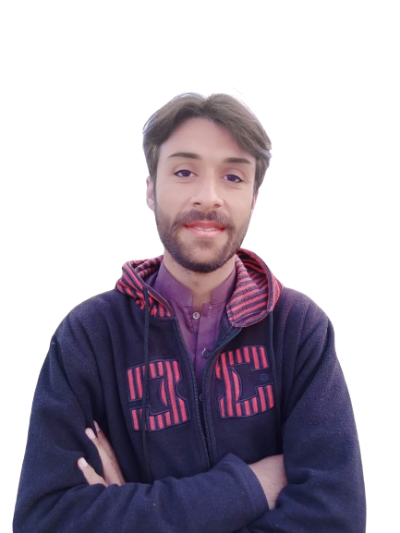
Intermediate Task Series
Problem Number 83

Slide 2
Problem Statement
Create a Desktop Python Program to insert a Image as button in Window.

Slide 3
Algorithm
Step1: Import tkinter module
Step2: Get a basic window
Step3: Insert a Image
Step4: Create a button having background image as inserted
Step5: Display result to user
END

Slide 4
Assignment
Create a Desktop Python Program to insert a Image as button with text in Window.

